Slide 1
CPDMS v10.0 Training
Isaac Hands, MPH
Lead Software Architect, Kentucky Cancer Registry
April 11, 2022

Slide 2
Summary of Changes Released April 5, 2022
CPDMS Updated according to NAACCR v22 Data Standards
New Fields for Data Entry: 7 Case, 2 Therapy
New Calculated Fields: 6 Case, 4 Therapy
6 Data Conversions Needing Manual Review
SEER EOD v2.1
ICD-O-3.2 Histology
CoC Standard 6.5 for Follow-Up
RCRS/NCDB Edits and Output Changes
New CPDMS Feature: Suspense List

Slide 3
New Fields for Data Entry
Field Name | Level | Case Types | Diagnosis Years
Tobacco Use Smoking Status | Case | All | 2022+
Macroscopic Evaluation of the Mesorectum | Case - SSDI | Topography C20.9 (Rectum, NOS) | 2022+
Derived Rai Stage | Case - SSDI | Lymphoma-CLL/SLL | 2018+
P16 | Case - SSDI | Cervix v9 | 2021+
LN Status Pelvic | Case - SSDI | Cervix v9, Cervix v8, Vagina, Vulva | 2018+
LN Status Para Aortic | Case - SSDI | Cervix v9, Cervix v8, Vagina, Vulva | 2018+
LN Status Femoral Inguinal | Case - SSDI | Cervix v9, Cervix v8, Vagina, Vulva | 2018+
Surgery Breast | Therapy - Surgery | Breast | 2022+
Reconstruction Breast | Therapy - Surgery | Breast | 2022+

Slide 4
New Calculated Fields
Field Name | Level | Case Types | Diagnosis Years
Ever Smoker | Patient | All | All
RX Hosp--Surg Breast | NAACCR Therapy | Breast | 2022+
RX Hosp--Recon Breast | NAACCR Therapy | Breast | 2022+
RX Summ--Surg Breast | NAACCR Therapy | Breast | 2022+
RX Summ--Recon Breast | NAACCR Therapy | Breast | 2022+

Slide 5
Data Conversions Needing Manual Review
1. Case now eligible for AJCC Staging. Review AJCC Staging values.
2. Schema changed to Soft Tissue Abdomen & Thoracic. Key change and review staging/SSDI values.
3. Schema changed to Soft Tissue Rare/Other (new). Key change and review staging/SSDI values.
4. Schema changed to Soft Tissue Rare (new). Key change and review staging/SSDI values.
5. Schema changed to Cervix Sarcoma (new). Key change and review staging/SSDI values.
6. Review p16 SSDI

Slide 6
SEER EOD v1.2
https://staging.seer.cancer.gov/eod/news/2.1/
All available automatic conversions were performed
Some conversions require manual review

Slide 7
ICD-O-3.2
https://www.naaccr.org/icdo3/
Updated CPDMS Histology lists with new ICD-O-3.2 codes

Slide 8
CoC Standard 6.5 Change for Follow-Up
https://www.facs.org/quality-programs/cancer/news/registry-change-031921
Updated ACoS criteria in Follow Up reporting for Recent/Long-Term Follow Up intervals defined in CoC Standard 6.5
KCR also maintains SEER follow-up, so facilities should continue to follow their younger population of patients back to 1995

Slide 9
RCRS/NCDB Edits and Output Changes
Edits have been updated to the v22 metafile and output will be in v22 XML

Slide 10
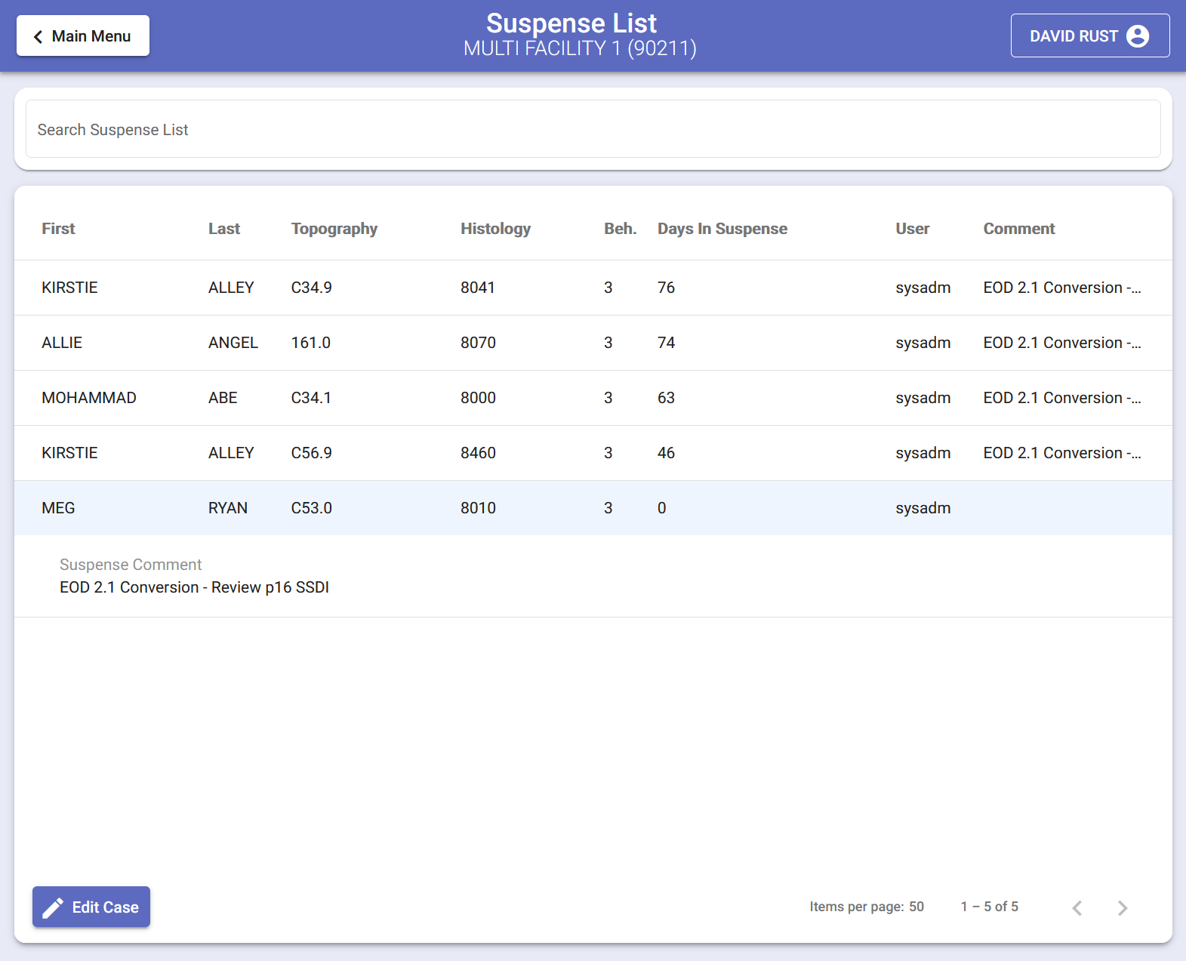
Suspense List
https://confluence.kcr.uky.edu/display/KAM/Suspense+List
Requested Feature to help with RCRS and workflow management
Used for v22 Manual Review
Plan to integrate with Casefinding in future release

Slide 11
Using Suspense List for v22 Manual Review
https://confluence.kcr.uky.edu/display/KAM/NAACCR+V22+Manual+Review+and+the+Suspense+List
Demo

Slide 12
Suspense List vs. Incomplete List
 | Suspense List | Incomplete List
What type of record is on the list? | Case | Patient
How is a record added? | By a CPDMS user, manually By the CPDMS System | Automatically, when any case or patient fails edits
Can records be manually removed from the list? | Yes | No
Are records automatically removed from the list when they pass edits? | Yes, if it was added manually and has never passed edits or Yes, if it was added by the CPDMS System | Yes
Are records ever left on the list when they pass edits? | Yes, if a case was added manually after it was considered complete | No
How many records can be on the list? | Unlimited | 20 per hospital facility

Slide 13
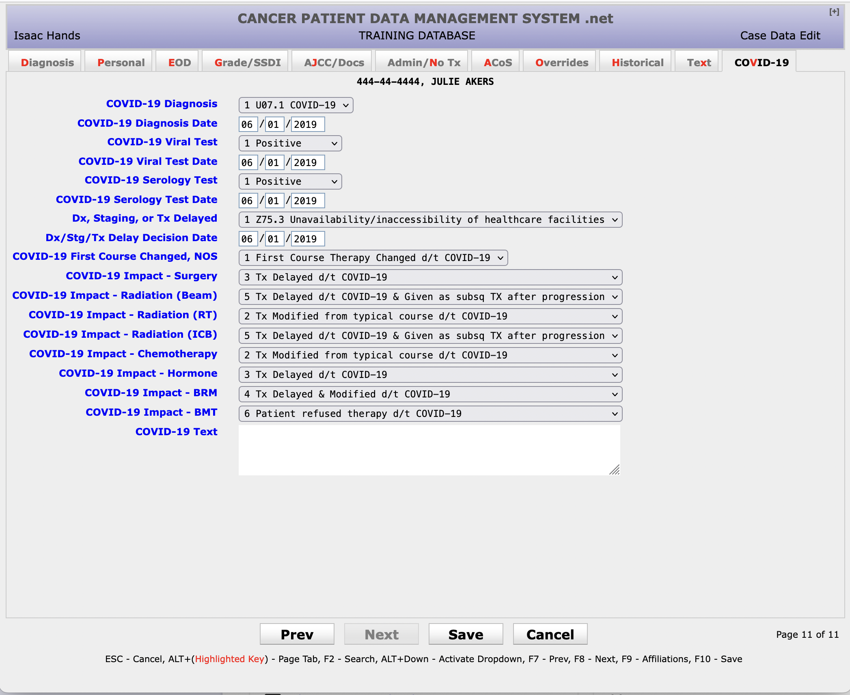
COVID-19 Data Collection
KCR is still requiring Covid-19 data collection for 2022 – in order to meet SEER data collection requirements
CPDMS Release Notes said Covid-19 data collection was removed, but it will be re-enabled this week (week of April 11, 2022)

Slide 14
CPDMS Support
Monday-Friday, 7 AM to 5 PM Eastern Time
(859) 218-2222
cpdmsnetsupport@uky.edu

